Slide 1

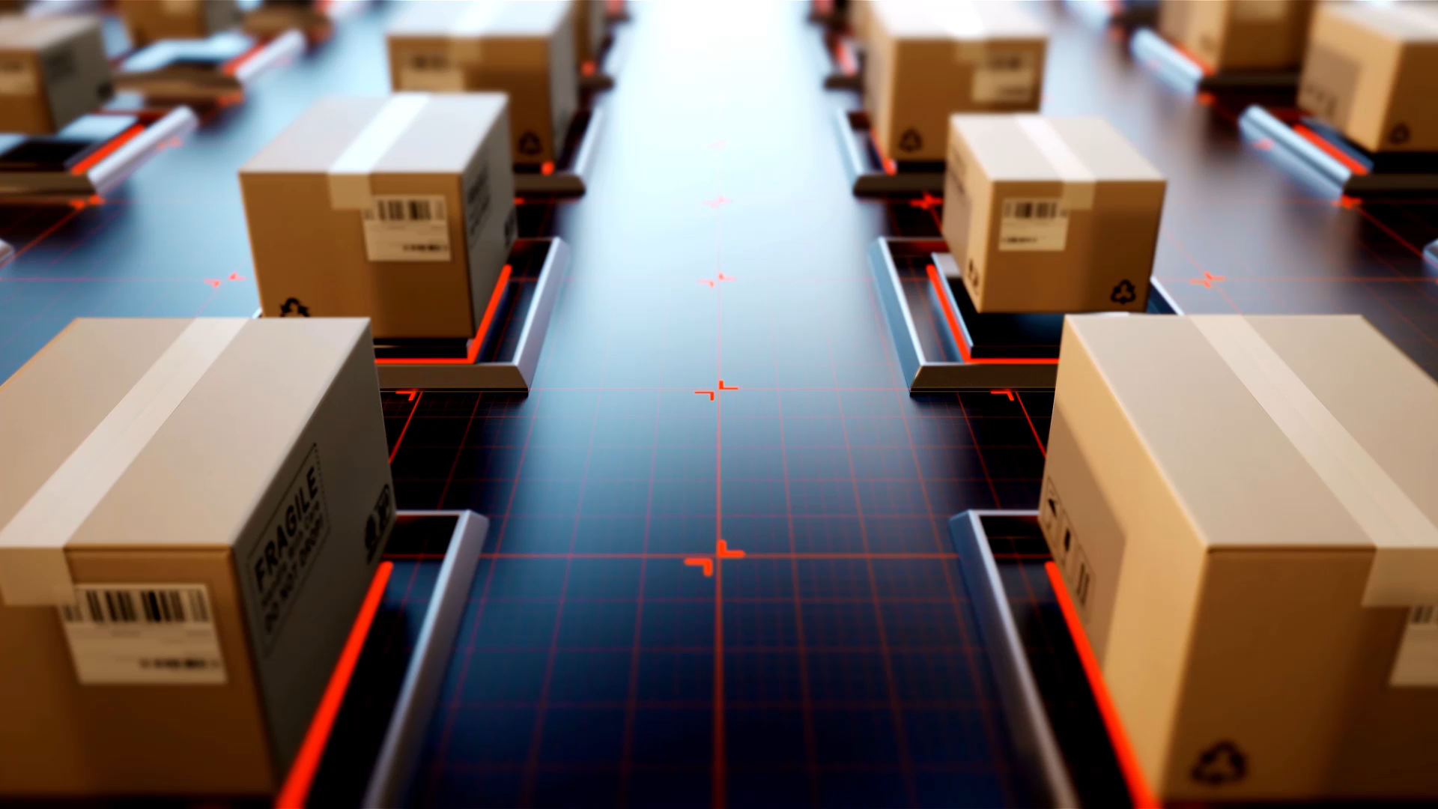
ENPM 667 Controls For Robotic Systems
IMPLEMENTATION OF A KALMAN FILTER IN POSITIONING FOR AUTONOMOUS VEHICLES, AND ITS SENSITIVITY TO THE PROCESS PARAMETERS
Submitted by:
Jeet Patel: 117430479
Dhyey Patel: 117396553

Slide 2
Abstract
Since last two decades, autonomous vehicles are being used more and more .With these localization and accurate estimation of the positioning of the autonomous vehicle becomes very crucial.
Common localization techniques include visual odometry and localization using triangulation. But with the need of the industry more and more accuracy is required in the positioning of the autonomous vehicle.
This report analyzes and gives a detail explanation of the journal paper “IMPLEMENTATION OF A KALMAN FILTER IN POSITIONING FOR AUTONOMOUS VEHICLES, AND ITS SENSITIVITY TO THE PROCESS PARAMETERS” and implements the proposed position estimation technique.
It is based on accurate position estimation of the autonomous vehicle. The selected journal paper implements the Kalman filter-based estimation technique for accurate position estimation. And the said technique is implemented on a AGV in a manufacturing industry environment.

Slide 3
Introduction
What is an AGV?

Slide 4
To begin with, let us understand what an AGV is. An automated guided vehicle (AGV) or mobile robot is a type of guidance robot system that is not restricted by a fixed range of motion. Rather, it is self-contained and can move along lines, surfaces, or spaces. This is different from a robot arm that is attached to the base and consists of limbs and joints. In most cases, automatic guided vehicles and robot arms are combined. Self-driving cars act as mobile platforms with robotic arms to perform more versatile functions such as remote control, remote control, scanning and probing.
AGVs are used to transport raw materials such as metal, plastic, rubber and paper. AGVs can, for example, transport raw materials from inbound goods to warehouses or deliver materials directly to production lines. AGVs deliver the raw materials they need continuously and reliably without human intervention, so the materials they need on the production line are always supplied uninterrupted.

Slide 5
Following are the types of AGVs:
Automatic Guided Carts: An AGC is a simple AGV with limited automation that follows a strip painted on the floor, travels a given path, and performs repetitive actions. AGV carts are widely used in sorting, warehousing and cross-docking applications to reduce labor costs.
Unit Loader AGV: These AGV transfer trolleys are designed to move specific parts or products with special tools to move pallets or containers containing multiple items.
Heavy Load AGVs: These rugged AGVs are used to transport heavy loads over long distances within large systems without the help of fixed route operators. This path can be easily changed by turning or following the floor belt. The
Forklift/Towing AGVs: This AGV is an automatic guided vehicle developed as a storage robot for warehousing and draws orders from high places using forks and other special tools developed for specific applications.
Tugger AGV: Tugger AGV uses a trailer filled with products or parts to tow heavy cargo from point A to point B. These automated guided vehicles can make multiple scheduled stops as they move between factories, factories, or warehouses.

Slide 6
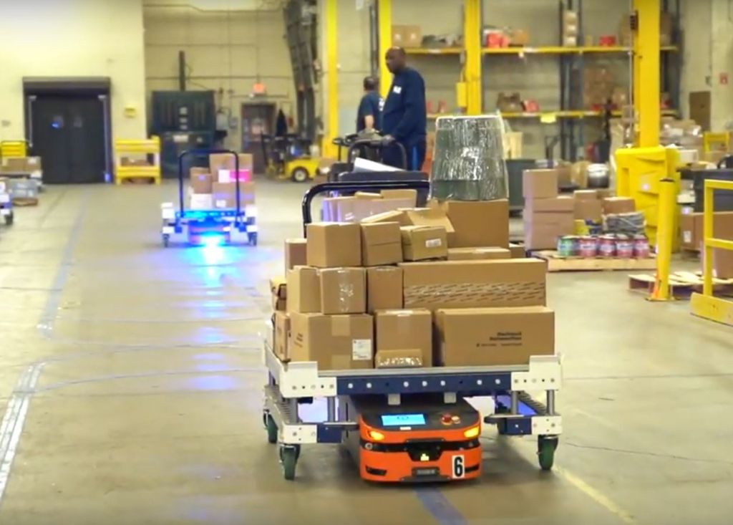

Slide 7
Overview Of AGV ROBI
In the selected journal paper the proposed positioning technique is tested on a mobile robot ROBI. This mobile robot is shown in figure below. The type of the driving unit is asynchronous. So, basically there are two types synchronous and asynchronous motors.
The controller is built into the electric motor, which simplifies the process without commutators or slip rings. And in the mobile robot ROBI two stepper motors have been fitted. The stepper motors are used instead of stable rotation to provide step angle rotation. The total angle of rotation of each rotor is known to be 180 degrees. However, you can use a stepper motor to divide the total rotation angle into many steps, such as 10 degrees x 18 steps. This means that the rotor will gradually move 18 times, 10 degrees each time, in a complete cycle of rotation. This is very useful for the given task of material handling. Apart from that the mobile robot has four castor wheels.

Slide 8
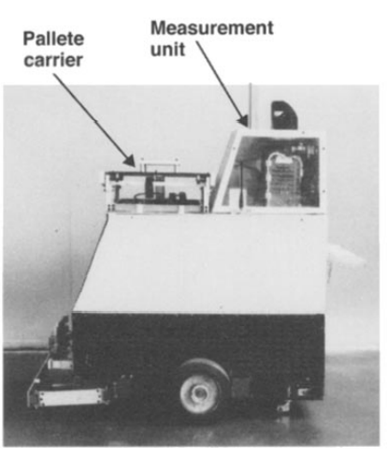
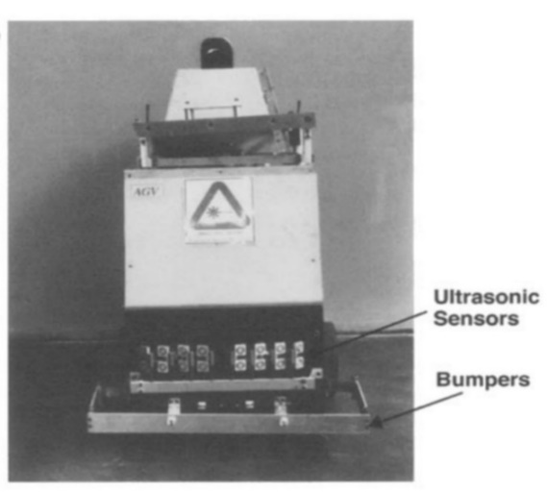
General Structure of ROBI

Slide 9
Moreover, the measurement unit consists of a laser system which is low powered. A rotating laser is a more advanced laser that rotates a light beam fast enough to produce a 360-degree horizontal or vertical effect, illuminating not only the solid line but also the horizontal plane. Laser beam projectors use a rotating head with a mirror to rotate the laser beam around a vertical axis. If the mirror is not self-leveling, it is equipped with a human-readable level and manually adjustable screws to level the projector. Personnel carried by the operator are equipped with a movable sensor that can detect the laser beam and output a signal when the sensor is aligned with the beam.
The measuring unit consists of a rotating low power laser system. The system continuously sends a thin beam parallel to the ground. The plurality of reflectors are arranged at predetermined positions in the working area in order to reflect the laser beam back to the photodetector on the robot. The angular position of the rotating assembly is measured by the optical encoder, which detects the position as soon as the optical sensor detects the reflected beam. A series of optical lances and mirrors focus the transmitted and reflected laser beam to the required wavelengths. The device rotates at 3 Hz and can reliably detect reflectors up to 10 m (30 feet) from a vehicle. The system resolution is 1.7 x 10.3 rad (0.1 °). The reflector is 500m long and has a square profile 15 × 15mm. In theory, a circular profile is preferred, but such a profile reduces the bandwidth of the reflector and reduces the effective distance to only 3 m (10 ft). This is shown in figure below.

Slide 10
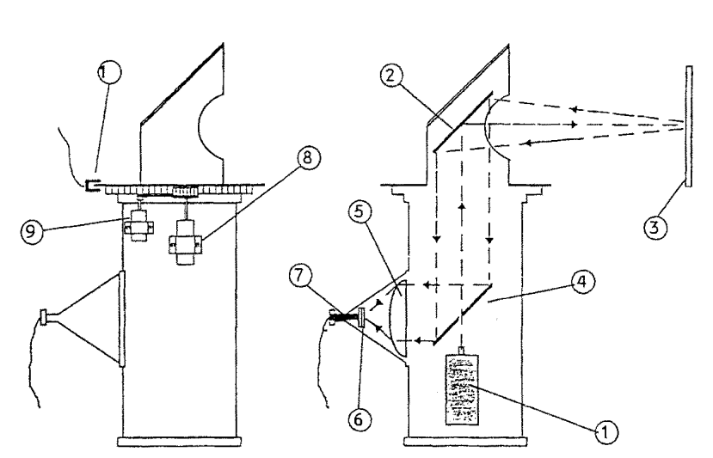
The measuring unit
1. Laser transmitter. 2. Rotating mirror. 3. Reflector.
4. Stationary mirror. 5. Lens.
6. Optical filter.
7. Optical sensor.
8. d.c. Motor.
9. Encoder.
10. Calibration sensor.

Slide 11
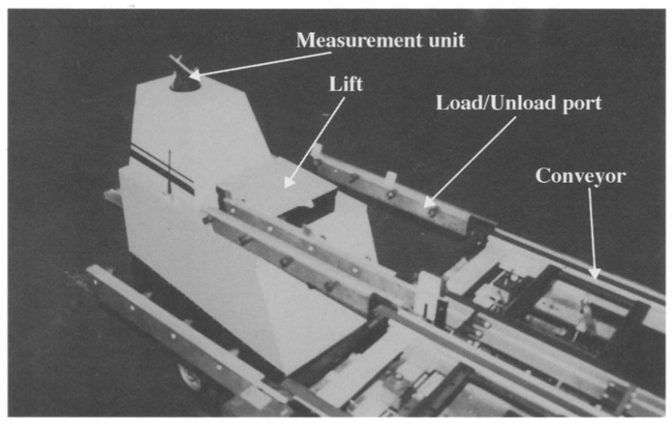
The figure besides shows a vehicle entering one of the conveyor docking stations. The loading operation raises the lift before the AGV enters the port. After accurate positioning, lower the lift and pull the pallet out of the conveyor belt. For unloading, the process is reversed and the AGV moves to the port with the lift in the lower position. After the vehicle is placed, the lift lifts the pallet, and the vehicle leaves the harbor. The robot is equipped with a mechanical bumper that cuts off the power supply to the drive motor in the event of a collision. It also has an ultrasonic sensor, communication antenna and control / interface panel for obstacle detection and avoidance.

Slide 12
Background On Position Estimation
Localization or positioning is a core component of an autonomous guided vehicle. Since AGV drives on their own it is constantly required to know the current position of the AGV in order to reach the desired location or in order to carry out desired task. Positioning or localization is a capability of an AGV which makes them pinpoint to their current location inside the space. Various methods have been evolved throughout past few years. And the accuracy of the positioning system kept on increasing after evolution of every new technique. Selection of a particular positioning technique largely depends on the kind of application and kind of the resources like sensors and other stuff. Let us discuss some commonly used positioning techniques in AGVs.
Free Range positioning technique: It is very flexible and widely used in autonomous vehicles. Since it is very good for unstructured and unknown environments it is very popular technique.
Rigid navigation System: Rigid navigation systems guide vehicles with limited flexibility in predefined lanes. Common fixing methods include mechanical railroad tracks which is similar to railroad tracks, electrical / magnetic systems that guide vehicles through underfloor wire guides, optical / chemical strips placed on the surface of the floor.

Slide 13
Inertial based Navigation System: The Inertial Navigation System is a self-contained device consisting of an Inertial Measurement Unit (IMU) and a Computational Unit. An IMU typically consists of a 3-axis accelerometer, a 3-axis gyroscope, and possibly a 3-axis magnetometer, which measures the angular velocity and acceleration of the system. A computing unit used to determine the attitude, position, and speed of a system based on raw measurements from an IMU given an initial starting position and orientation. So, basically INS uses a computer, motion sensor (accelerometer), and rotation sensor (gyroscope) to position and direct moving objects without the need for external references and a navigation device that continuously calculates speed ,direction and speed of movement.
Triangulation: Triangulation is a method of calculating a position based on a known distance between two measuring devices and the measurement angle from these two points to the object. This works in conjunction with the angle-side-angle triangle congruence theorem to find the position of an object.
Beacon Based Navigation: In this method the positioning of the AGV is carried out by the relative positioning of the vehicle with respect to the beacons or landmarks whose position is already known. The measurements can be angular as well as linear. And the beacons can be any transmitter receiver system like ultrasonic sensors, satellites or infrared waves.

Slide 14
Why data fusion of position-based navigation system??
Moreover, it is not appropriate to rely on a single technique of positioning if very high accuracy is required. In this case fusion comes in the role. Fusing the data and outputs of various sensor and then estimating the desired result is known as sensor fusion. Even in the task of positioning sensor fusion improves the accuracy very drastically. Estimation of position often uses different data like odometry with other sensors to get the correct estimation.
In the selected journal paper a robust positioning system has been proposed. The proposed positioning system fuses the data of odometry, a rotating beam of lasers having retro reflectors and Kalman filter. And the proposed positioning technique is tested on a mobile robot ROBI, which is placed in an industrial environment. The industrial environment is a flexible manufacturing system. The system includes two CNC cells with robots for loading and unloading, two robot assembly stations, an inspection and quality control station, and a linear one-way conveyor for material transfer. Each CNC cell and conveyor belt has a docking point for interfacing with the AGV.

Slide 15
Overview On Kalman Filter
One of the most significant and widely used estimate algorithms is the Kalman Filter. The Kalman Filter generates hidden variable estimates based on erroneous and imprecise measurements. In addition, the Kalman Filter predicts the future state of the system based on previous estimates.
In the face of uncertainty, one of the most difficult issues for tracking and control systems is to provide accurate and precise assessment of hidden variables. For example, consider the measurement uncertainty of GPS receivers is affected by a variety of external factors, including thermal noise, atmospheric effects, minor variations in satellite locations, receiver clock precision, and so on. In such case Kalman filters prove to be very useful and crucial for the accurate estimation.

Slide 16
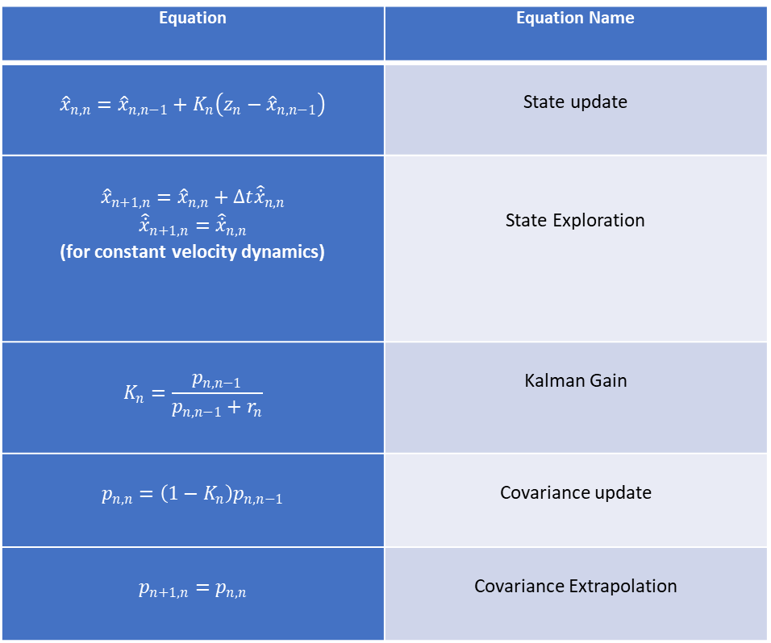
Kalman Filter Equations
Equation | Equation Name
$${\hat{x}}_{n,n}={\hat{x}}_{n,n−1}+K_{n}\left(z_{n}−{\hat{x}}_{n,n−1}\right)$$ | State update
$${\hat{x}}_{n+1,n}={\hat{x}}_{n,n}+Δt{\hat{\dot{x}}}_{n,n}$$ $${\hat{\dot{x}}}_{n+1,n}={\hat{\dot{x}}}_{n,n}$$ (for constant velocity dynamics) | State Exploration
$$K_{n}=\frac{p_{n,n−1}}{p_{n,n−1}+r_{n}}$$ | Kalman Gain
$$p_{n,n}=\left(1−K_{n}\right)p_{n,n−1}$$ | Covariance update
$$p_{n+1,n}=p_{n,n}$$ | Covariance Extrapolation

Slide 17
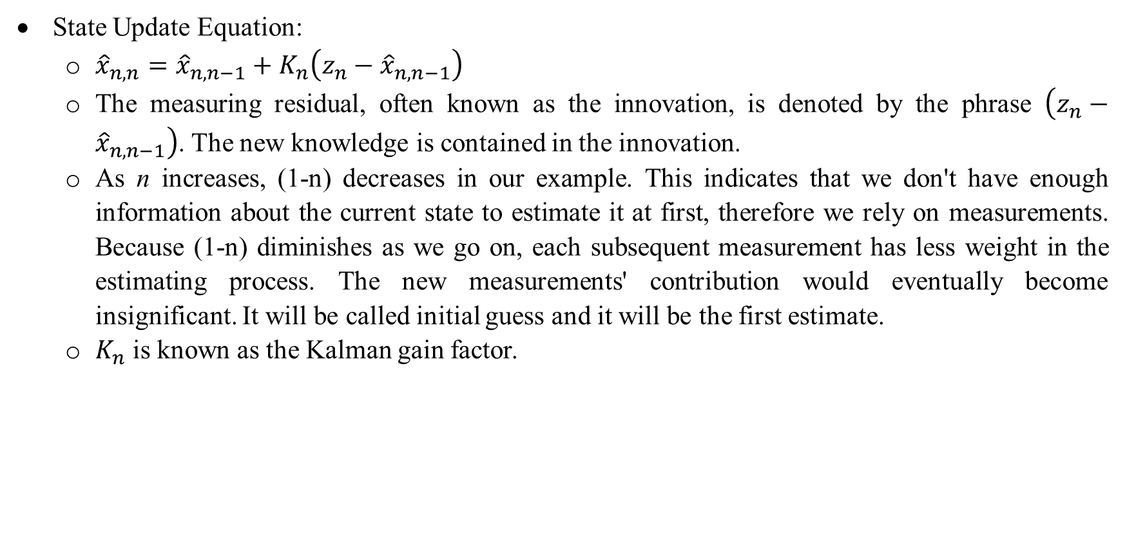
State Update Equation:
${\hat{x}}_{n,n}={\hat{x}}_{n,n−1}+K_{n}\left(z_{n}−{\hat{x}}_{n,n−1}\right)$
The measuring residual, often known as the innovation, is denoted by the phrase $\left(z_{n}−{\hat{x}}_{n,n−1}\right)$. The new knowledge is contained in the innovation.
As n increases, (1-n) decreases in our example. This indicates that we don't have enough information about the current state to estimate it at first, therefore we rely on measurements. Because (1-n) diminishes as we go on, each subsequent measurement has less weight in the estimating process. The new measurements' contribution would eventually become insignificant. It will be called initial guess and it will be the first estimate.
$K_{n}$ is known as the Kalman gain factor.

Slide 18
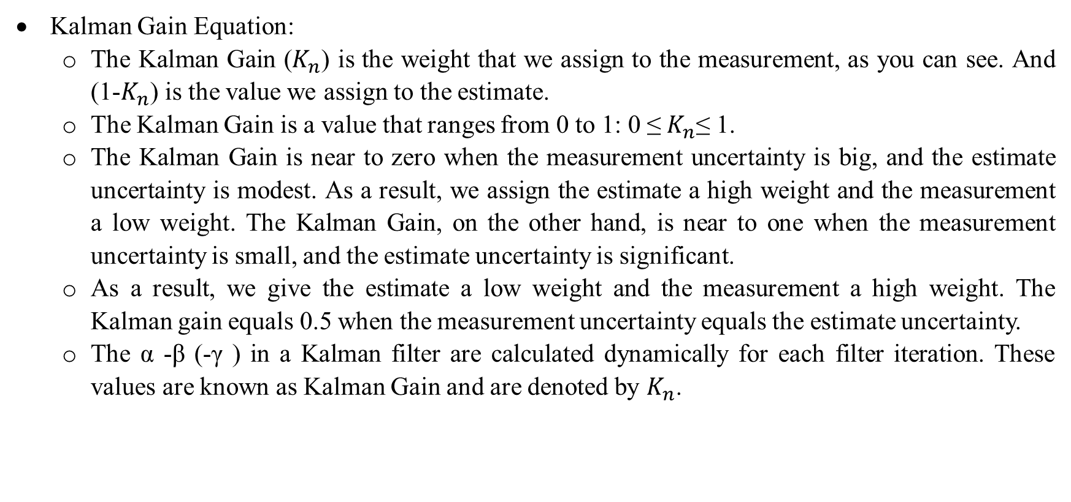
Kalman Gain Equation:
The Kalman Gain ($K_{n}$) is the weight that we assign to the measurement, as you can see. And (1-$K_{n}$) is the value we assign to the estimate.
The Kalman Gain is a value that ranges from 0 to 1: 0 ≤${ K}_{n}$≤ 1.
The Kalman Gain is near to zero when the measurement uncertainty is big, and the estimate uncertainty is modest. As a result, we assign the estimate a high weight and the measurement a low weight. The Kalman Gain, on the other hand, is near to one when the measurement uncertainty is small, and the estimate uncertainty is significant.
As a result, we give the estimate a low weight and the measurement a high weight. The Kalman gain equals 0.5 when the measurement uncertainty equals the estimate uncertainty.
The α -β (-γ ) in a Kalman filter are calculated dynamically for each filter iteration. These values are known as Kalman Gain and are denoted by $K_{n}$.

Slide 19
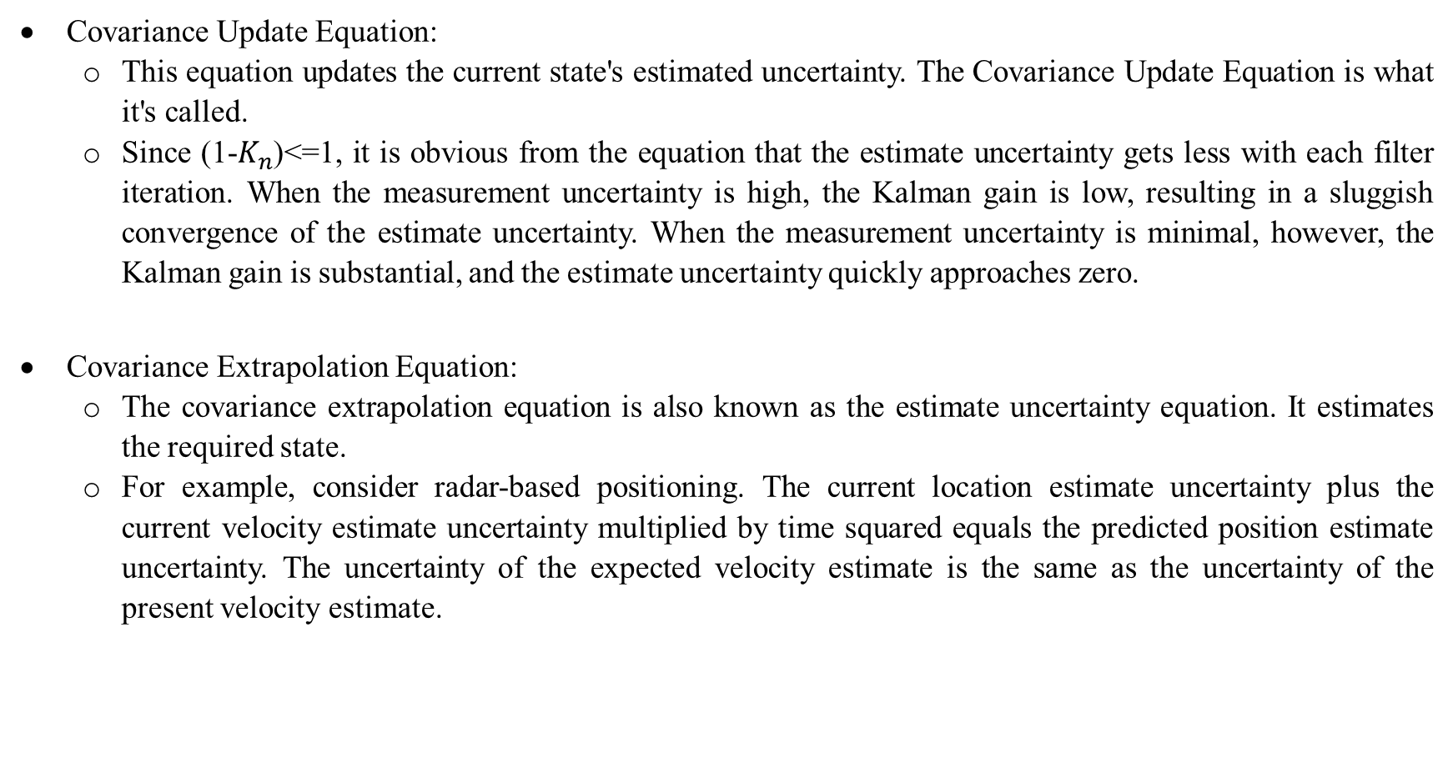
Covariance Update Equation:
This equation updates the current state's estimated uncertainty. The Covariance Update Equation is what it's called.
Since (1-$K_{n}$)<=1, it is obvious from the equation that the estimate uncertainty gets less with each filter iteration. When the measurement uncertainty is high, the Kalman gain is low, resulting in a sluggish convergence of the estimate uncertainty. When the measurement uncertainty is minimal, however, the Kalman gain is substantial, and the estimate uncertainty quickly approaches zero.
Covariance Extrapolation Equation:
The covariance extrapolation equation is also known as the estimate uncertainty equation. It estimates the required state.
For example, consider radar-based positioning. The current location estimate uncertainty plus the current velocity estimate uncertainty multiplied by time squared equals the predicted position estimate uncertainty. The uncertainty of the expected velocity estimate is the same as the uncertainty of the present velocity estimate.

Slide 20
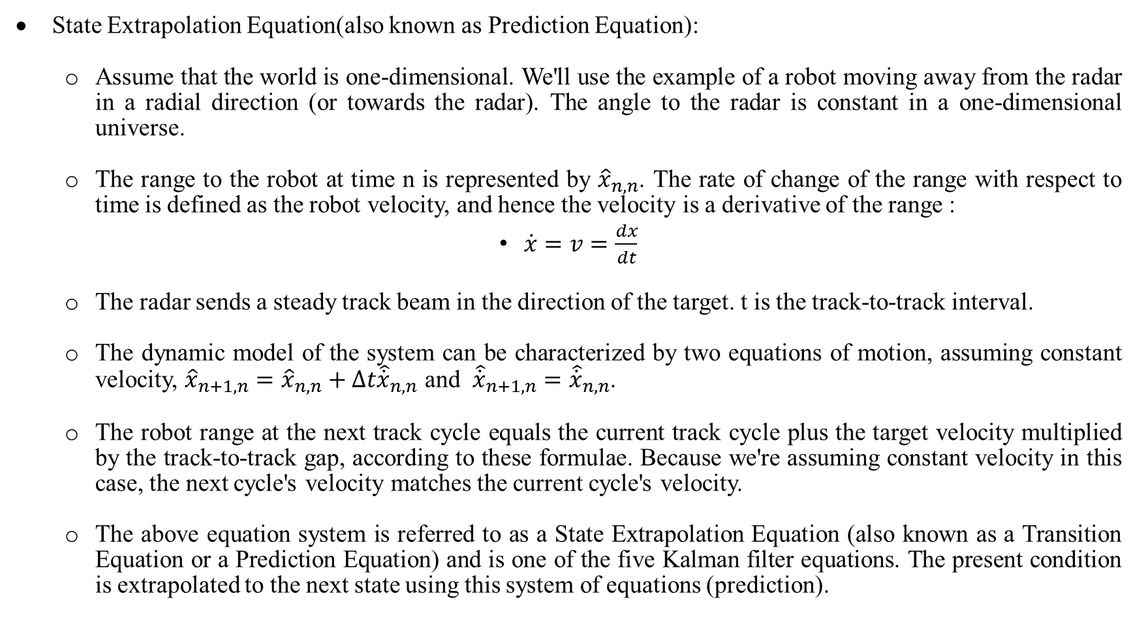
State Extrapolation Equation(also known as Prediction Equation):
Assume that the world is one-dimensional. We'll use the example of a robot moving away from the radar in a radial direction (or towards the radar). The angle to the radar is constant in a one-dimensional universe.
The range to the robot at time n is represented by ${\hat{x}}_{n,n}$. The rate of change of the range with respect to time is defined as the robot velocity, and hence the velocity is a derivative of the range :
$\dot{x}=v=\frac{dx}{dt}$
The radar sends a steady track beam in the direction of the target. t is the track-to-track interval.
The dynamic model of the system can be characterized by two equations of motion, assuming constant velocity, ${\hat{x}}_{n+1,n}={\hat{x}}_{n,n}+Δt{\hat{\dot{x}}}_{n,n}$ and ${\hat{\dot{x}}}_{n+1,n}={\hat{\dot{x}}}_{n,n}$.
The robot range at the next track cycle equals the current track cycle plus the target velocity multiplied by the track-to-track gap, according to these formulae. Because we're assuming constant velocity in this case, the next cycle's velocity matches the current cycle's velocity.
The above equation system is referred to as a State Extrapolation Equation (also known as a Transition Equation or a Prediction Equation) and is one of the five Kalman filter equations. The present condition is extrapolated to the next state using this system of equations (prediction).

Slide 21
Summary Of Kalman Filter
The Kalman filter cycle can be summarized as follows:
Step 0: The initialization is performed only once.
Initial state system.
Initial state uncertainty.
Initialization is followed by prediction.
Step1: Measurement
Measurement state system.
Measurement uncertainty.

Slide 22
State2: State Update
The state update process is responsible for current state estimation.
Measured value , measurement uncertainty.
Previous system state estimate and estimate uncertainty.
Based on inputs, the state update process will give the Kalman gain and will provide current system state estimate and current state estimate uncertainty.
State3: Prediction
Based on the system's dynamic model, the prediction process extrapolates the present system state and the uncertainty of the current system state estimate to the next system state.
The initialization results are treated as the Previous State Estimate and Uncertainty in the first filter iteration.
The prediction outputs become the Previous State Estimate and Uncertainty as the filter iterations go.

Slide 23
Position Estimation With Kalman Filter
For the mobile robot in the selected journal paper, there are two sources of data for the estimation of the position of the mobile robot. The first one is the data from Odometry. And the second is the data from triangulation. But none of the mentioned techniques are sufficient for the accurate estimation of the position of the mobile robot.
This is because, only relative position can be determined using odometry and it starts accumulating errors as the distance travelled increases. Furthermore, accurate positioning of the robot can be obtained by using method of triangulation if the robot is stationary, but the robot is not going to be stationary always. And if triangulation method is performed while the robot is in motion then very inaccurate positioning estimate can be obtained. All these factors lead to having some method which is more reliable and accurate. As a result, a need for fusion arises. In the method used in the journal paper, the data of odometry and the angular measurements of the beacons can be fused with the Kalman filter which gives the accurate estimation of the position of the mobile robot.

Slide 24
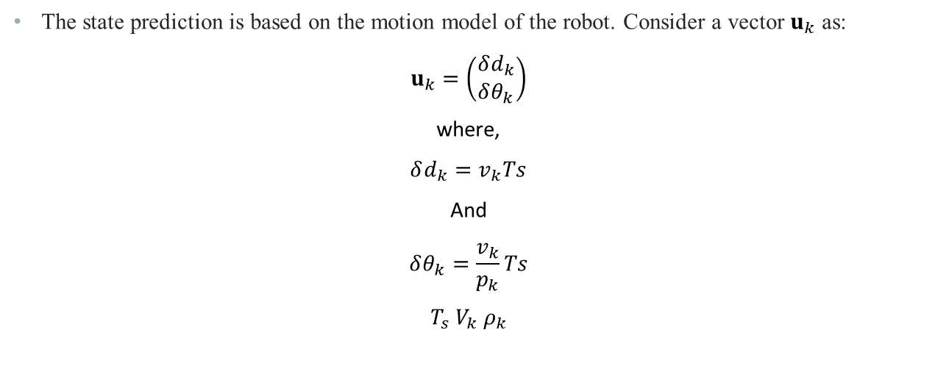
State Prediction
The state prediction is based on the motion model of the robot. Consider a vector $u_{k}$ as:
$$u_{k}=\left(\begin{aligned}&δd_{k} \\ &δθ_{k}\end{aligned}\right)$$
where,
$$δd_{k}=v_{k}Ts$$
And
$$δθ_{k}=\frac{v_{k}}{p_{k}}Ts$$
$T_{s}$ $V_{k}$ $ρ_{k}$

Slide 25
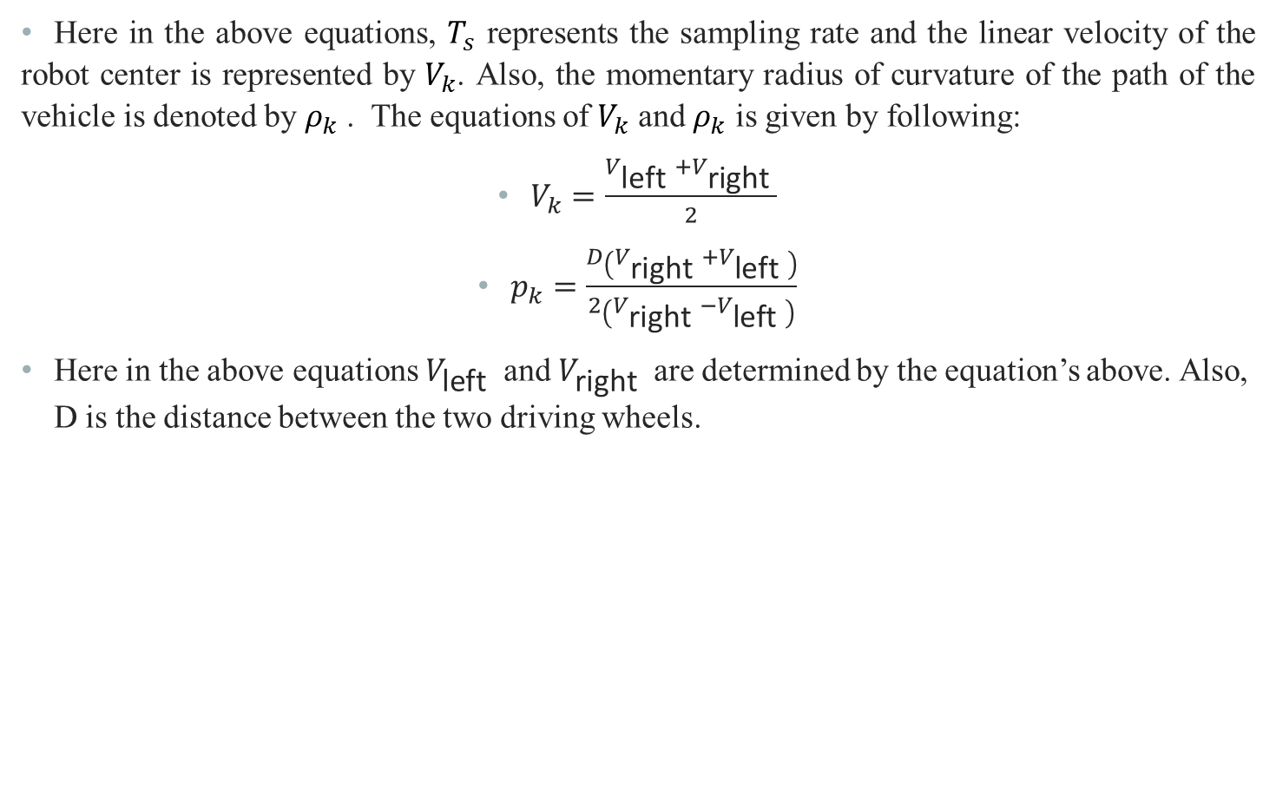
Here in the above equations, $T_{s}$ represents the sampling rate and the linear velocity of the robot center is represented by $V_{k}$. Also, the momentary radius of curvature of the path of the vehicle is denoted by $ρ_{k}$ . The equations of $V_{k}$ and $ρ_{k}$ is given by following:
$V_{k}=\frac{V_{\text{left} }+V_{\text{right} }}{2}$
$p_{k}=\frac{D\left(V_{\text{right} }+V_{\text{left} }\right)}{2\left(V_{\text{right} }−V_{\text{left} }\right)}$
Here in the above equations $V_{\text{left} }$ and $V_{\text{right} }$ are determined by the equation’s above. Also, D is the distance between the two driving wheels.

Slide 26
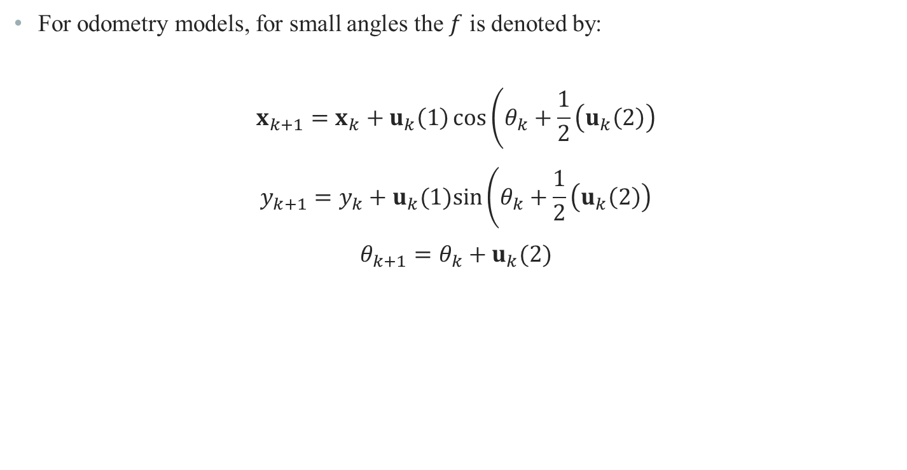
For odometry models, for small angles the $f$ is denoted by:
$$x_{k+1}=x_{k}+u_{k}\left(1\right)\cos\left(θ_{k}+\frac{1}{2}\left(u_{k}\left(2\right)\right)\right.$$
$$y_{k+1}=y_{k}+u_{k}(1)sin⁡\left(θ_{k}+\frac{1}{2}\left(u_{k}\left(2\right)\right)\right.$$
$$θ_{k+1}=θ_{k}+u_{k}(2)$$

Slide 27
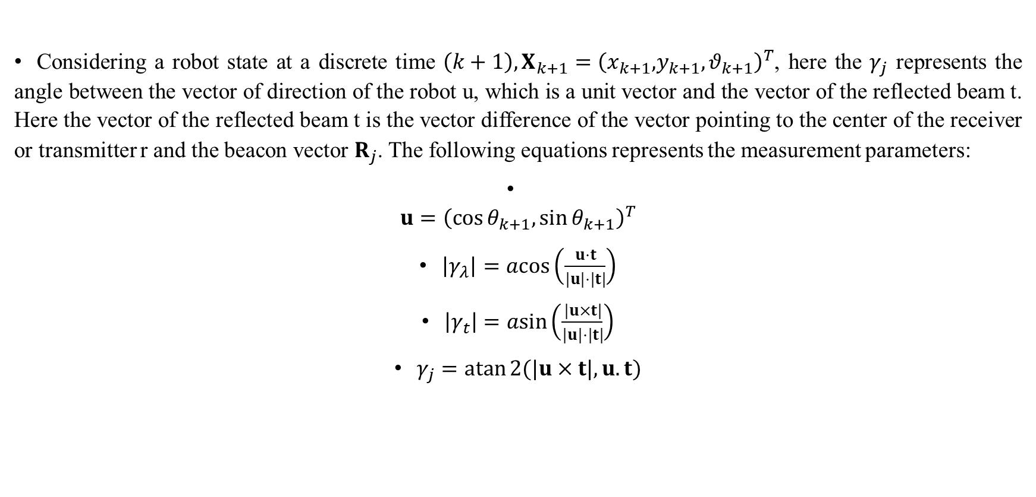
Measurement Prediction
Considering a robot state at a discrete time $\left(k+1\right),X_{k+1}=\left(x_{k+1},\right.{\left.y_{k+1},θ_{k+1}\right)}^{T}$, here the $γ_{j}$ represents the angle between the vector of direction of the robot u, which is a unit vector and the vector of the reflected beam t. Here the vector of the reflected beam t is the vector difference of the vector pointing to the center of the receiver or transmitter r and the beacon vector $R_{j}$. The following equations represents the measurement parameters:
$u={\left(cos⁡θ_{k+1},sin⁡θ_{k+1}\right)}^{T}$
$\left|γ_{λ}\right|=acos⁡\left(\frac{u⋅t}{|u|⋅|t|}\right)$
$\left|γ_{t}\right|=asin⁡\left(\frac{|u×t|}{|u|⋅|t|}\right)$
$γ_{j}=atan⁡2(|u×t|,u.t)$

Slide 28
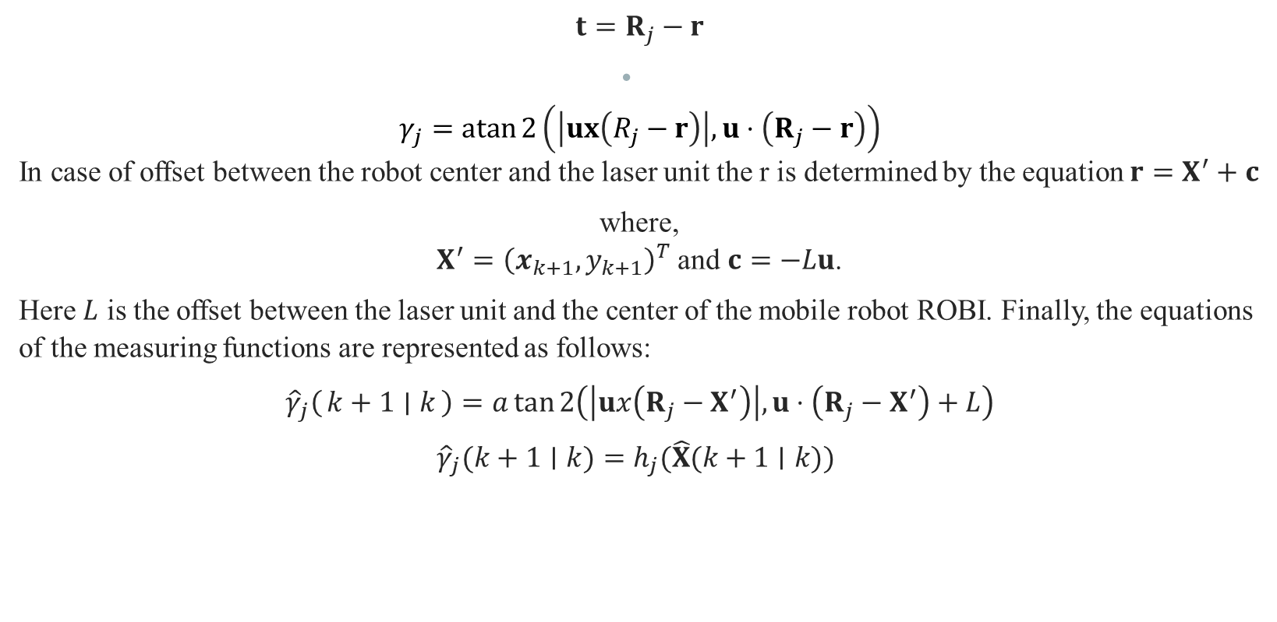
$$t=R_{j}−r$$
$$γ_{j}=atan⁡2\left(\left|ux\left(R_{j}−r\right)\right|,u⋅\left(R_{j}−r\right)\right)$$
In case of offset between the robot center and the laser unit the r is determined by the equation $r=X^{′}+c$
where, $X^{′}={\left(x_{k+1},y_{k+1}\right)}^{T}$ and $c=−Lu$.
Here $L$ is the offset between the laser unit and the center of the mobile robot ROBI. Finally, the equations of the measuring functions are represented as follows:
$${\hat{γ}}_{j}\left(k+1 ∣ k\right)=a\tan{2\left(\left|ux\left(R_{j}−X^{′}\right)\right|,u⋅\left(R_{j}−X^{′}\right)+L\right)}$$
${\hat{γ}}_{j}(k+1∣k)=h_{j}(\hat{X}(k+1∣k))$

Slide 29
Kalman Filter Gain
Kalman filter gain is one of the most crucial parts of Kalman filter. The performance of Kalman filter depends on the value of the Kalman filter gain. The value of Kalman gain is between 0 and 1. When producing a new estimate, the Kalman Gain defines a weight for the measurement and a weight for the old estimate. A significant Kalman Gain would arise from a low measurement uncertainty compared to the estimate uncertainty (close to 1).
This indicates that the new estimate will be reasonably close to the measurement. A low Kalman Gain would arise from a high measurement uncertainty compared to the estimate uncertainty (close to 0). This implies that the new estimate will be like the prior one.
There are several methods to determine the gain of Kalman filter. Here, the Kalman filter’s gain is derived by statistically analyzing the models and measurements occurring during the process. This statistical analysis provides a covariance matrix which as a result gives the Kalman filter gain.

Slide 30
To begin with, first of all it is required to consider the different errors which may occur considering the odometry model of the mobile robot. The sources of errors might be like the slippage occurring in the wheels or because of the uneven floor. Errors may also arise because of the uncertainty in the parameters related to the mechanical aspect of the mobile robot like, wheel alignment, wheels diameter, distance between the wheels and some other sources.
Considering the numerical errors which may occur in geometric calculations[4] suggested to random error in geometric calculation of both the right and left wheel. This was termed as adding white noise and each of the random noise was independent of each other. And based on this the gain is determined by experiment. Also, considering a new input vector which also includes the errors and also considering the actual angular and lateral displacements with errors the distance D which is the distance between both the wheels can be determined. And subsequently, odometry model can described as a combination of vector function and coefficient matrix of the error vector. And finally, the process covariance matrix can be obtained.

Slide 31
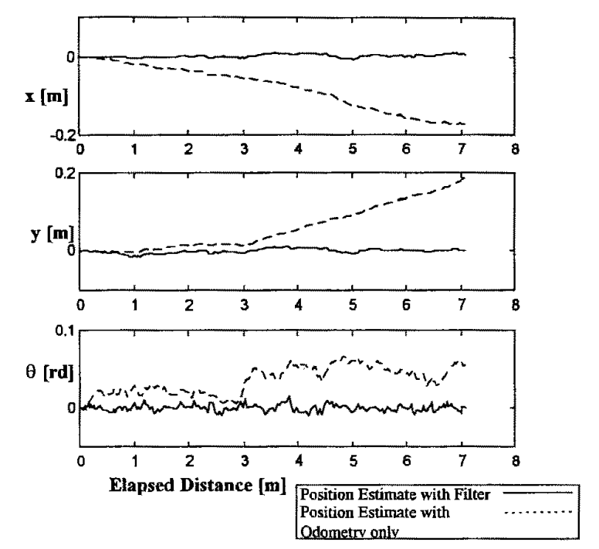
Results
This section discusses about the results derived from the test and simulation performed on the positioning estimation technique described in the journal paper. In the first experiment the simulation was carried out for offset of the odometry model compared against the offset obtained from the Kalman filter is shown in the figure besides. The following conclusions can be drawn from the simulation results:
As time and distance increases the offset of the odometry also increases.
The offset derived from the Kalman filter was always less than 1cm.
The error of the model of odometry estimation model gives a total lateral error of more than 0.2metres and in terms of orientation its gives error of 0.07 rad.
On the other hand, the error in the estimation of lateral position is less than 1cm and the error in orientation is less than 0.02 rad.

Slide 32
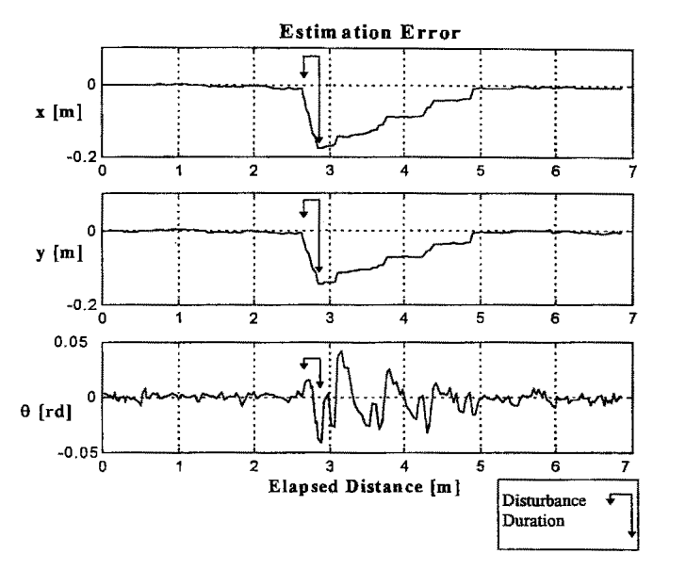
In the second experiment the conditions were made more practical. And as a part of that disturbances were introduced in each of the wheels. The disturbances were introduced in each wheel for 0.2 seconds. And the following conclusions were drawn from the experiment:
The error of the model of odometry estimation model gives a total lateral error of more than 0.4metres and in terms of orientation its gives error of 0.05 rad.
Whereas the Kalman filter significantly reduces both the errors to their minimum value after about 2 seconds.

Slide 33
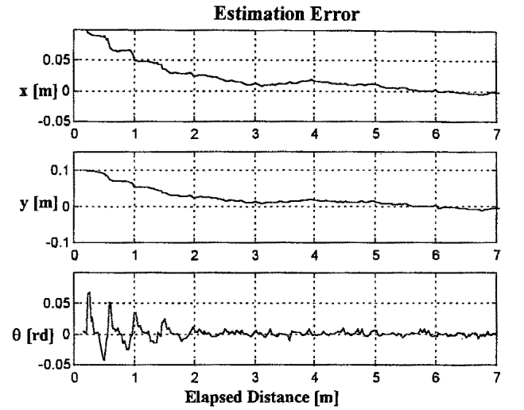
In the next experiment the response of the positioning estimation system was tested against the introduction of initial error in the position estimation, following are the conclusions
Damping of the error takes place.
And the position estimate reaches its nominal value after 3 seconds.
Also, some crucial phenomenon was noted. Regardless of the error introduced in the lateral position of the mobile robot, even the angular estimation was affected.
This phenomenon occurred because of the Kalman filter. The Kalman filter first of all compares the angular measurement of the reflectors with actual measurement.
Finally, the source of the error is detected by the Kalman filter after 1 seconds and the error in angular estimate is drastically reduced.

Slide 34
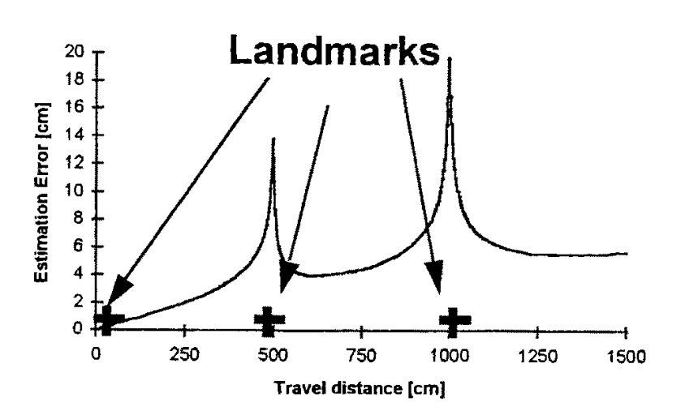
In the next and the final test, the Kalman filter is tested to the sensitivity of the beacon layout. And along the trajectory several beacons were placed at different locations. The figure shows the lateral error or deviation from the straight path. Following points were noted from the test:
There are clear areas where the lateral error is larger than the normal value of error.
On inspection it was found that the lateral errors increase when the beacons are in close contact with the mobile robot.
Here close contact is meant by when two or more beacons and the robot are in one line.
This can be explained by, if the lateral deviation is on the measurement line, then the estimated angular measurement is same as the actual measurement.

Slide 35
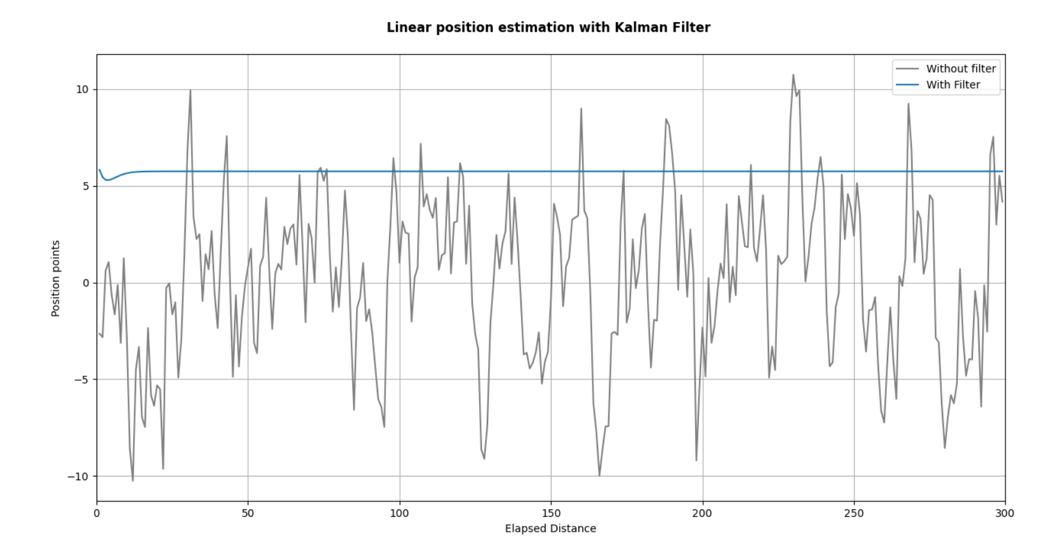
Implementation & It’s Results
The proposed estimation technique of the journal paper was implemented in python and following were the test results.
In the first test the performance of kalman filter was tested against normal odometry estimation. The result is shown in figure besides. It is evident that the performance of kalman filter with data fusion is very steady compared to the only odometry based estimation.

Slide 36
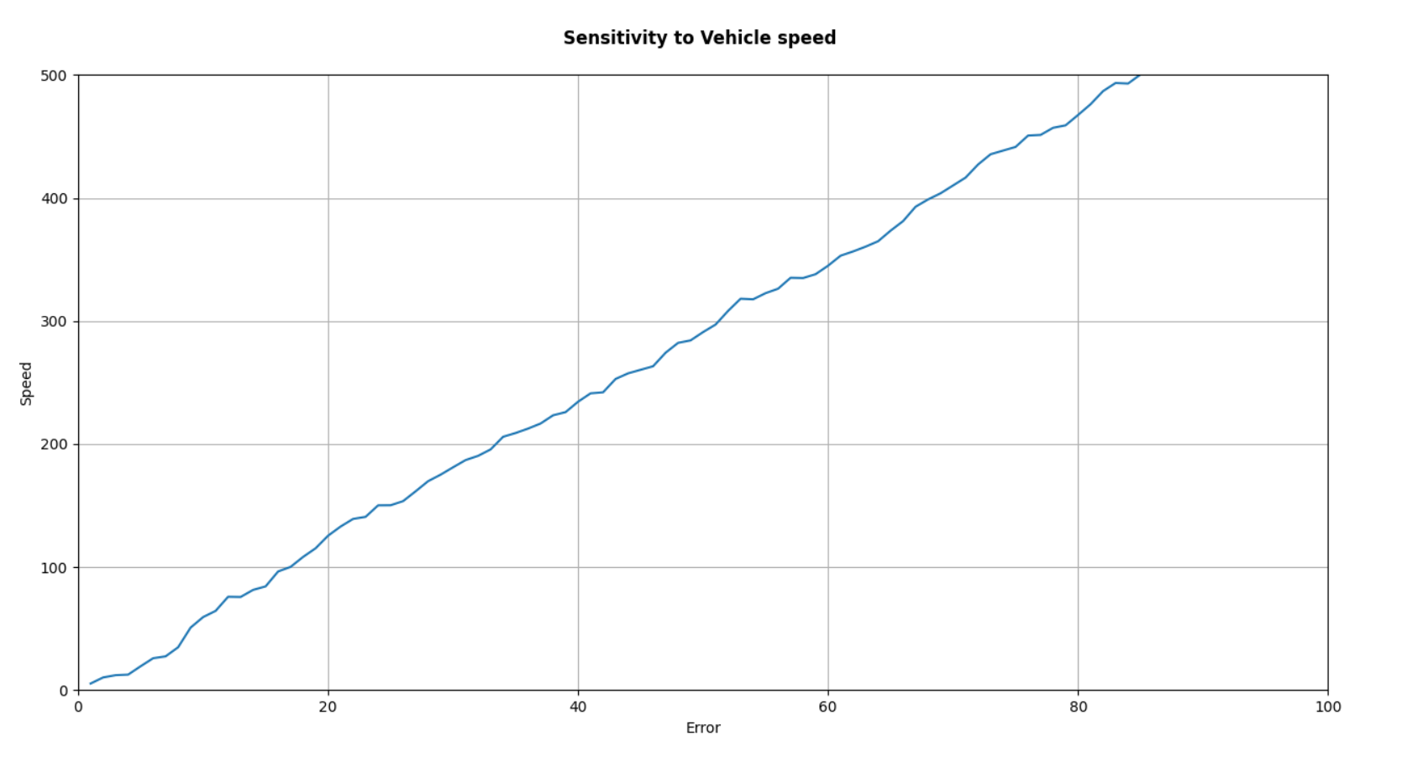
In the next test of the Kalman filter is tested against the speed i.e., filter’s performance to the vehicle speed is analyzed. The results are shown in figure besides. Following points were noted from the results:
There is an evident relationship between the estimated position error and the vehicle speed.
The relation between them is as expected, the error increases with the increase in the speed of the robot.
This is because when the mobile robot travels at higher speeds, the robot doesn’t perform angular measurement, which results in increased errors because of the increase in blind distance.

Slide 37
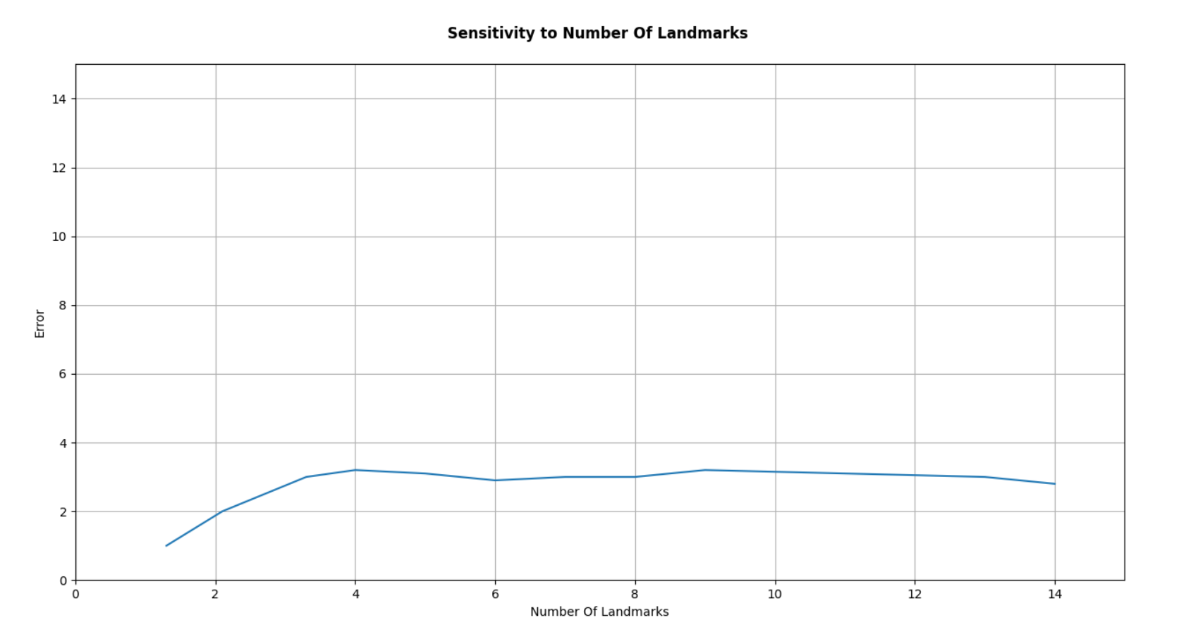
In the next test of the performance of Kalman filter is tested against the number of landmarks. It was assumed that during every travel the path was identical which helps to eliminate the effect of all other parameters except the landmarks. The following points were noted from the test results:
The effect is clearly more visible when the number of landmarks are less than 3.
And the effect is more significant on the lateral position estimate and the effect on angular position estimate is minimal.
Moreover, the filter is able to give estimation on lateral errors only after having some number of iterations. And it requires 3 seconds to recover.
While the filter can instantaneously detect the angular errors.

Slide 38
Conclusion
With the advancements in the robotics and automation industry, more and more autonomous robots or autonomous vehicles have incorporated into the manufacturing industry, in the day-to-day life and also in the consumer industry. And localization is one of the core components of the autonomous vehicle. Localization is the capability of an autonomous robot to precisely locate itself in the operating environment. For any autonomous vehicle it is very important to localize itself in order to carry out the required task. Many localization techniques have been evolved since last two three decades. In this report we discussed some techniques like odometry and triangulation for position estimation. But considering the accuracy of the required tasks and considering the practical uncertain working conditions, it was found that relying only on these techniques is not enough. And a need of data fusion was certain. It was required to deduce a technique which can perform estimation very well by fusing the data from the techniques like odometry and triangulation. And it was found that Kalman filter acts as one of the best estimating techniques. And the data coming from odometry, and triangulation was fused into the Kalman filter to carry out accurate position estimation.

Slide 39
On testing the algorithm based on the real implementation and from the results presented in the journal paper, one of the significant conclusions was that the filter performs better when the position error is in terms of orientation compared to the lateral position error. Also, the filter was able to offset the error within 3 seconds. Moreover, it can be deduced that error increases linearly with increase in speed. And also, the number of beacons and their orientation can significantly affect the performance of the filter. Hence, it can be concluded that the Kalman filter-based technique presented in the selected journal paper undoubtedly has a robust performance, but it also has some limitations with respect to the speed of the mobile robot as well as the number of beacons and their layout. Finally, there are also some advancements in the kalman filter like extended kalman filter and unscented kalman filter which may significantly improve the performance as well.

Slide 40
References
[1] S. Shoval, I. Zeitoun, and E. Lenz, “Implementation of a Kalman filter in positioning for autonomous vehicles, and its sensitivity to the process parameters,” The International Journal of Advanced Manufacturing Technology, vol. 13, no. 10, pp. 738–746, Oct. 1997.
[2] S. Shoval, I. Zaietun and E. Lenz. "Layout of beacons for triangulation of AGV's in industrial environment", Proceedings of the 13th International Conference on Production Research, Jerusa­ lem, Israel, pp. 485-488, August 1995.
[3] R. E. Kalman, “A New Approach to Linear Filtering and Prediction Problems,” J. Basic Eng., vol. 82, no. 1, p. 35, 1960.
[4] M. Tang, Z. Chen, and F. Yin, “Robot Tracking in SLAM with Masreliez-Martin Unscented Kalman Filter,” International Journal of Control, Automation and Systems, vol. 18, no. 9, pp. 2315–2325, May 2020.

Slide 41
References (2)
[5] Q. Li, R. Li, K. Ji, and W. Dai, “Kalman Filter and Its Application,” in 2015 8th International Conference on Intelligent Networks and Intelligent Systems (ICINIS), 2015, no. 10, pp. 74–77.
[6] Hidekata Hontani and Yuya Higuchi, “Kalman filtering for improving car positioning with measurements of relative distance,” SICE Annual Conference 2007, Sep. 2007, doi: 10.1109/sice.2007.4421490.
[7] M. Wang, H. Hu, X. Wang, H. Zhang, and A. Zhang, “An improved method of adaptive Kalman filtering for vehicular kinematic positioning,” Proceedings of the 33rd Chinese Control Conference, Jul. 2014, doi: 10.1109/chicc.2014.6896726.
[8] U. Wiklund, U. Andersson and K. Hyyppa, "AGV navigation by angle measurements", Proceedings of the 6th International Conference on Automated Guided Vehicle Systems, pp. 199-212, October 1988.
[9] “Understanding the Kalman Filter,” The American Statistician, 2012. https://www.tandfonline.com/doi/abs/10.1080/00031305.1983.10482723.
[10] H.-J. von der Hardt, P. Arnould, D. Wolf and M. Dufant, "A method of mobile robot localization by fusion of odometrical and magneto metric data", International Journal of Advanced Manufacture Technology, pp. 65--69, 1994.
[11] H. Chen, H. Lim, S. Hwang, and J. Lee, “Efficient driving of tracking robot using kalman filters,” 2013 13th International Conference on Control, Automation and Systems (ICCAS 2013), Oct. 2013, doi: 10.1109/iccas.2013.6703874.

Slide 42
Thank You

